Slide 1
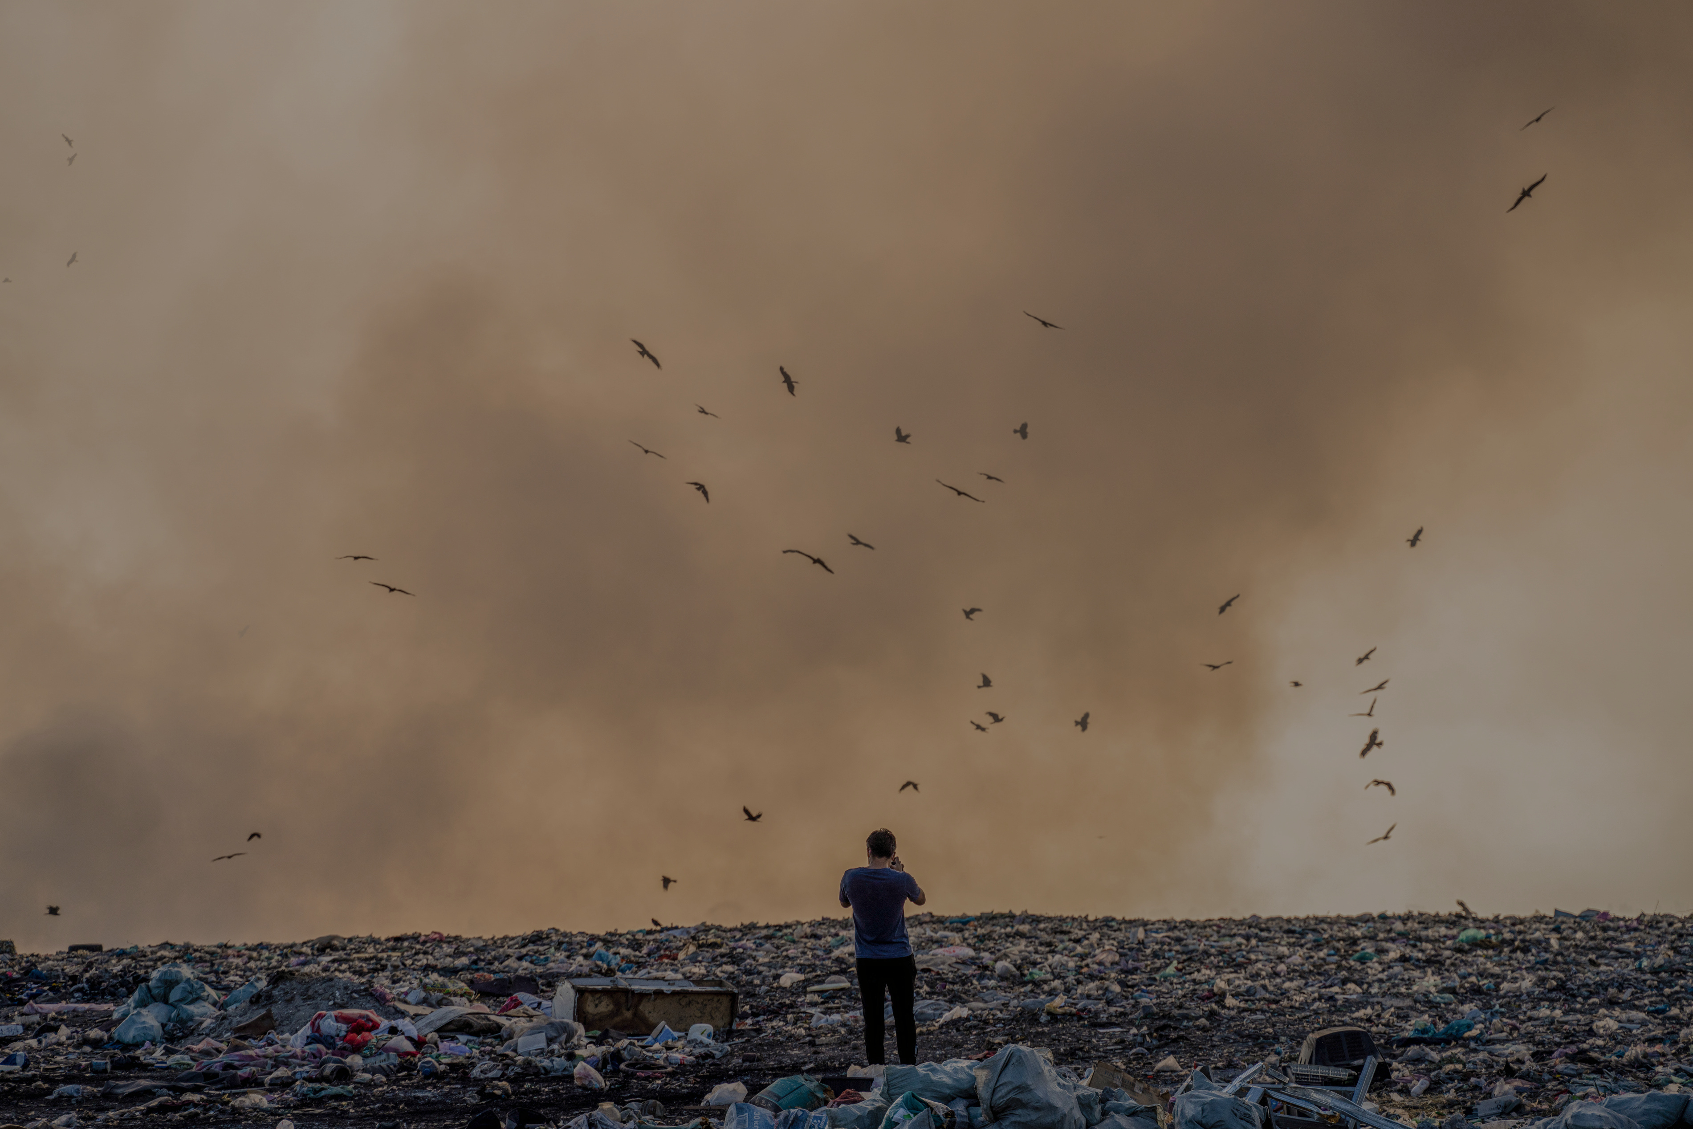
Capstone project
Global Air Pollution
Hussain Ali Jassim

Slide 2
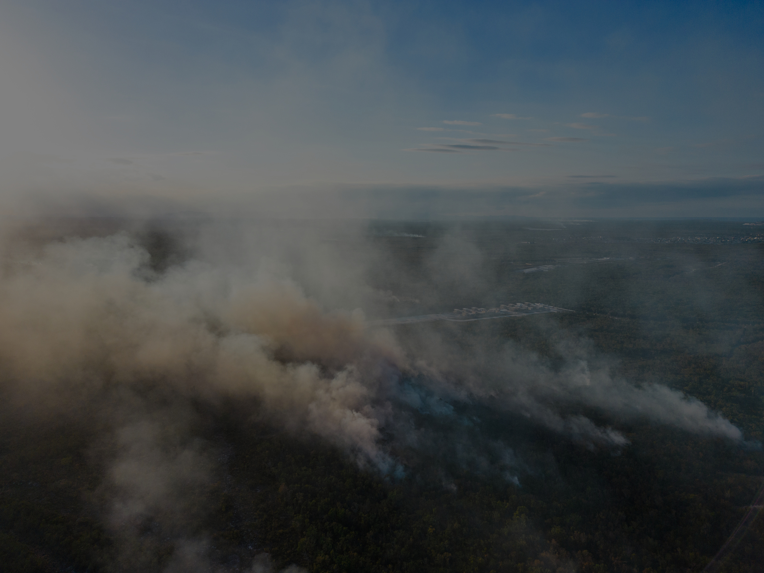
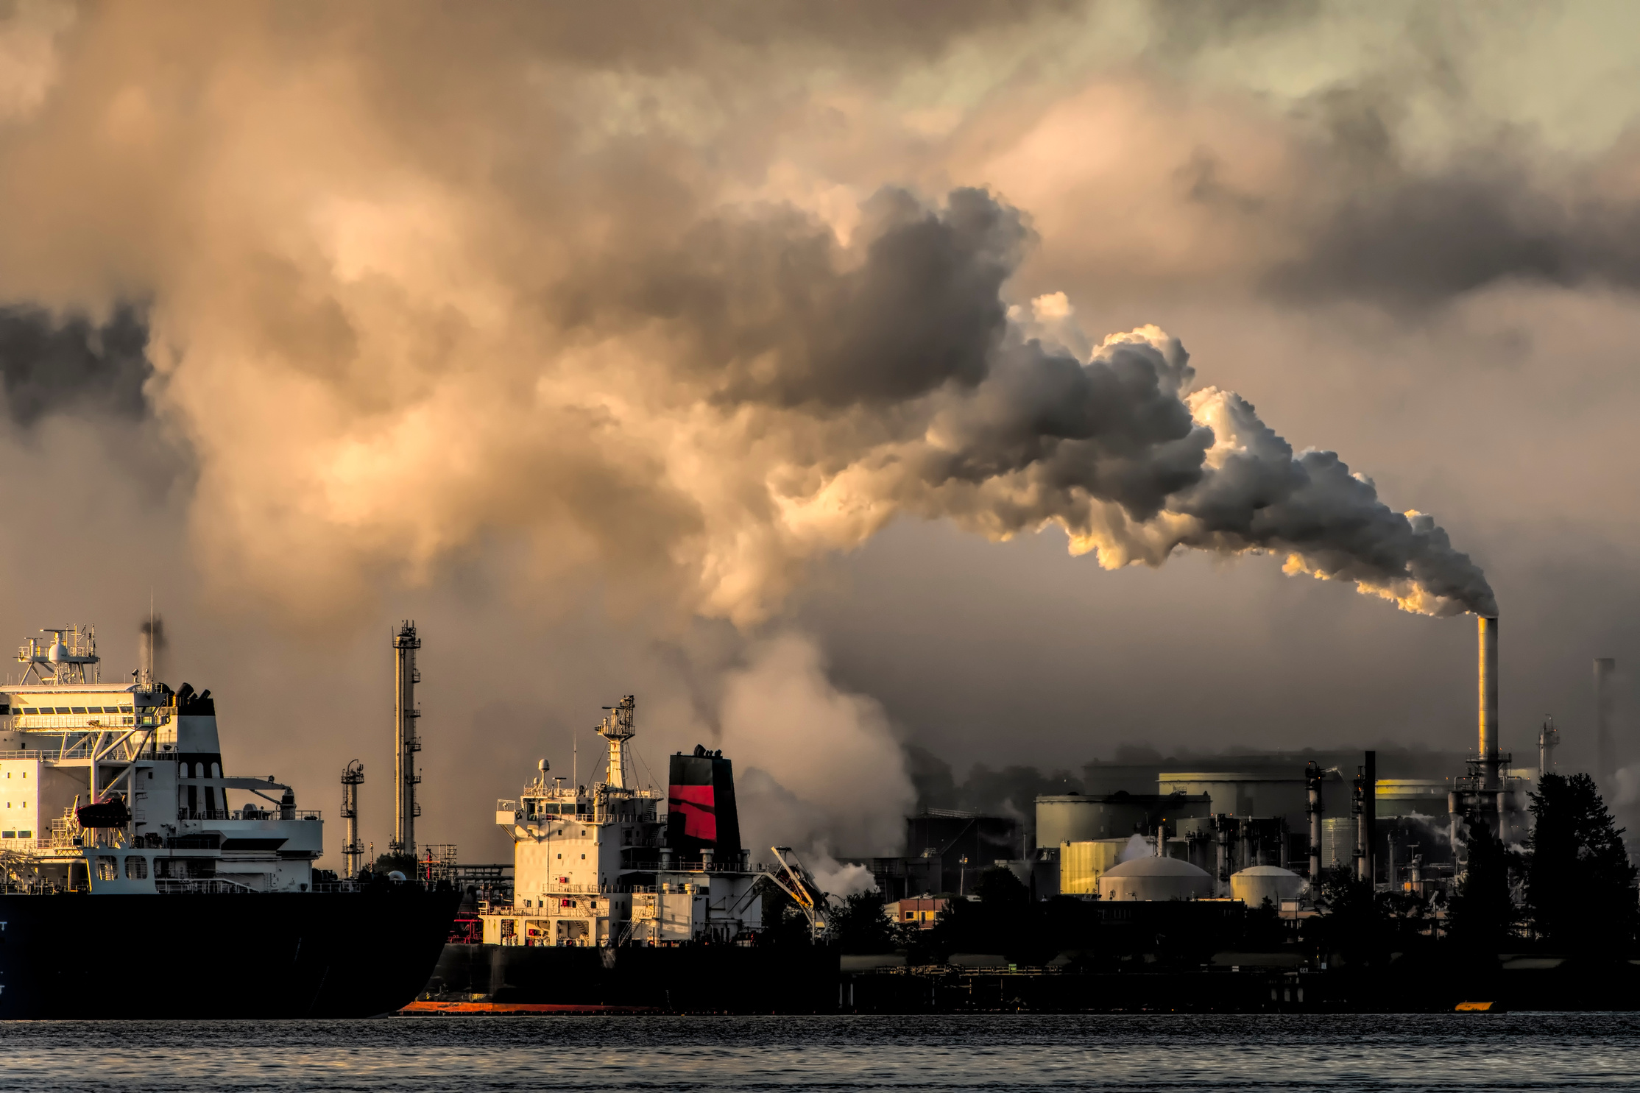
Introduction
Air pollution is one of the problems facing the world in our modern era, as air pollution negatively affects human life by causing serious diseases or destroying food crops such as plants and fish.

Slide 3
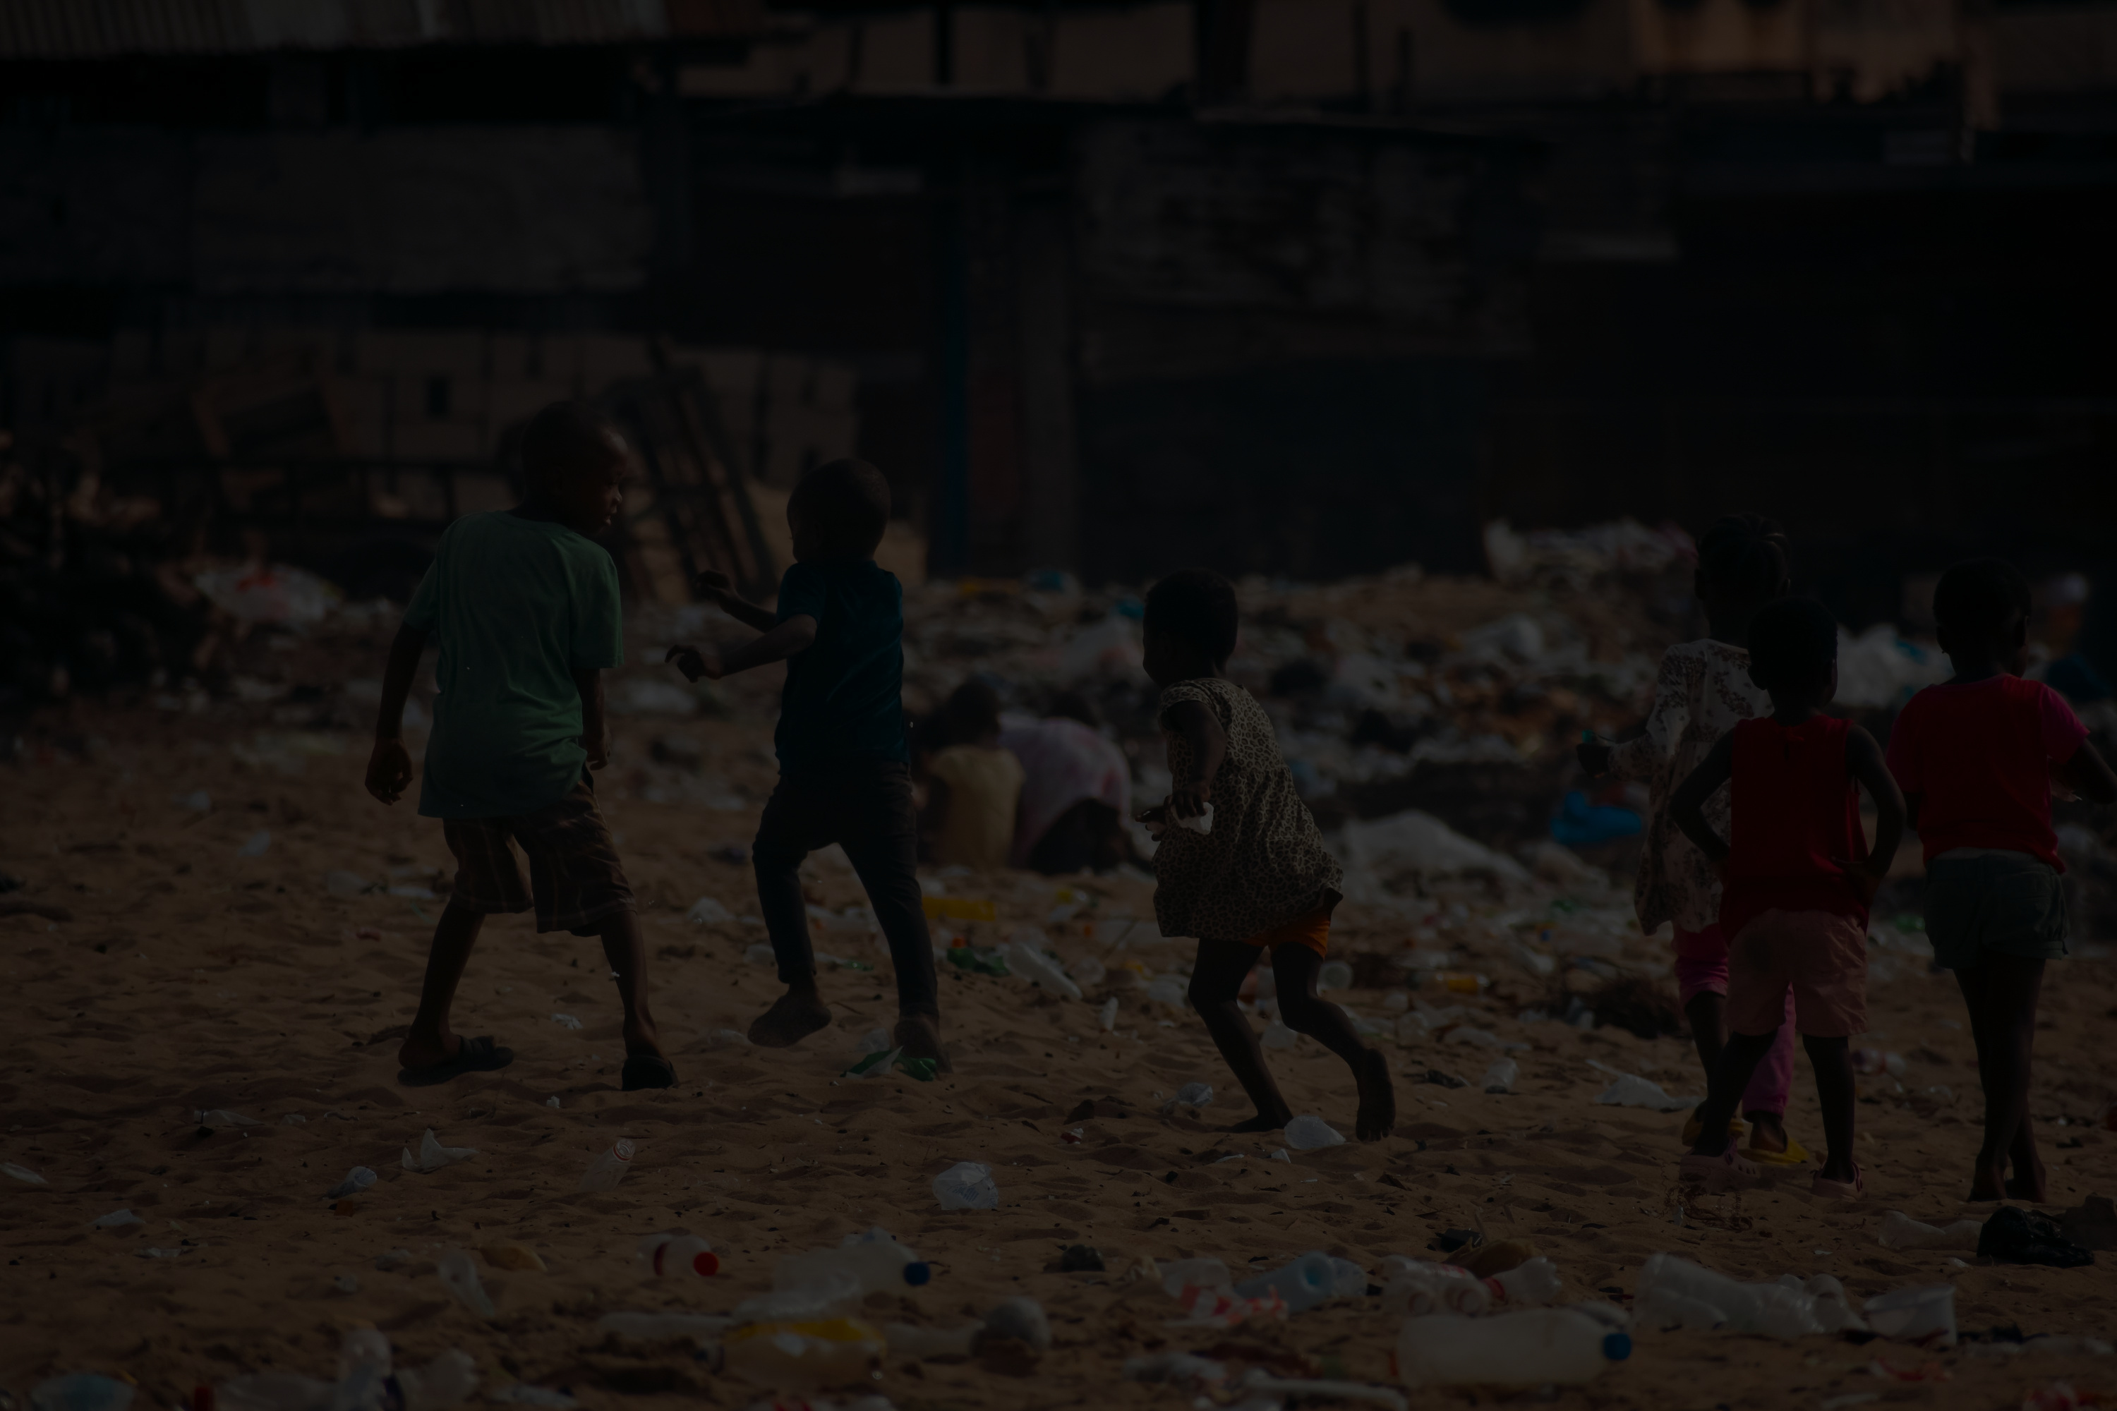
Audiences
Government or Policy Makers
Companies and Industrial Organizations
Local Community / General Public

Slide 4
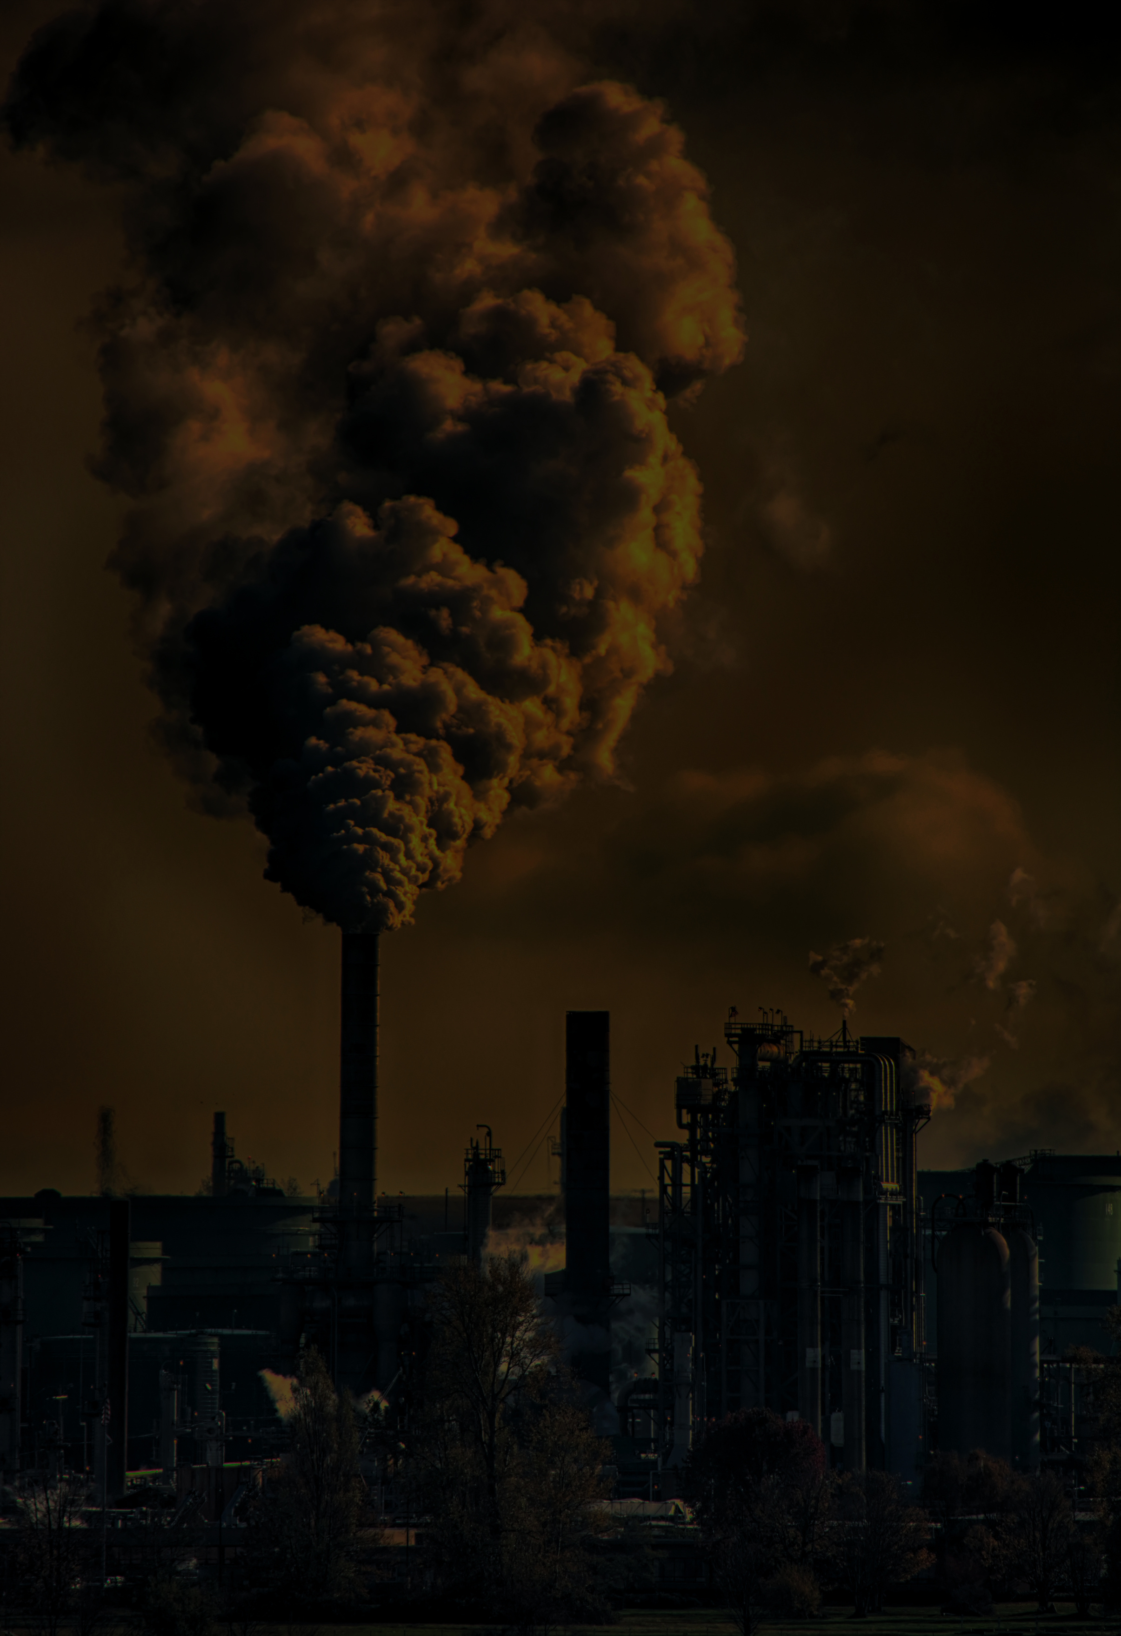
Problem statement
According to WHO
Air pollution is a critical global issue causing 7 million deaths annually, exposing 90% of people to unsafe air, and costing the world economy $8 trillion each year. Immediate action is needed to reduce its health and economic impacts.

Slide 5

23k city around 128 country
AQI
Ozone AQI
CO AQI
A value that shows the level of total air pollution.
Effect on breathing and plants.
Effect on the heart and brain.
NO2 AQI
PM2.5
Population
Effect on the lungs.
A value that shows fine particles smaller than 2.5 microns in the air
A value that shows how many people are exposed to pollution and its health effects.

Slide 6
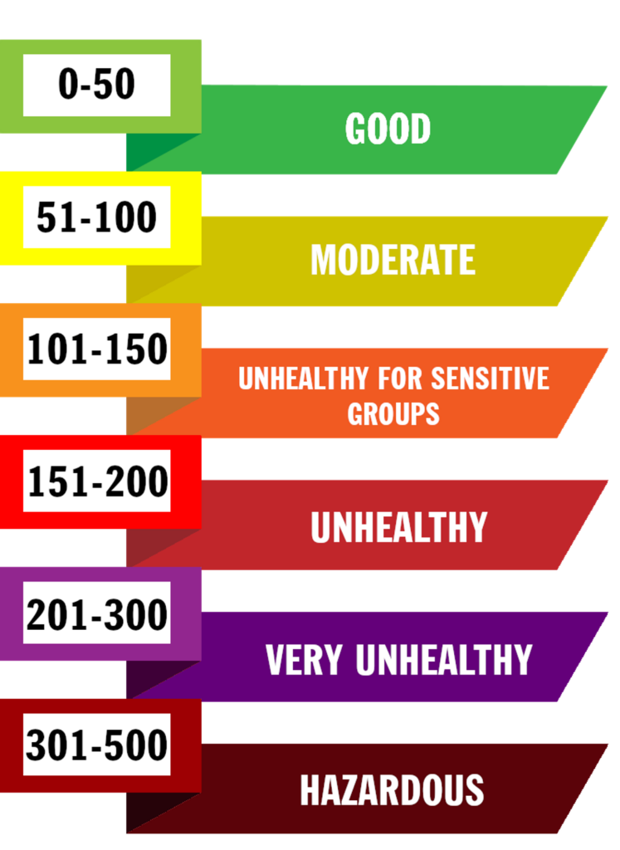

Slide 7
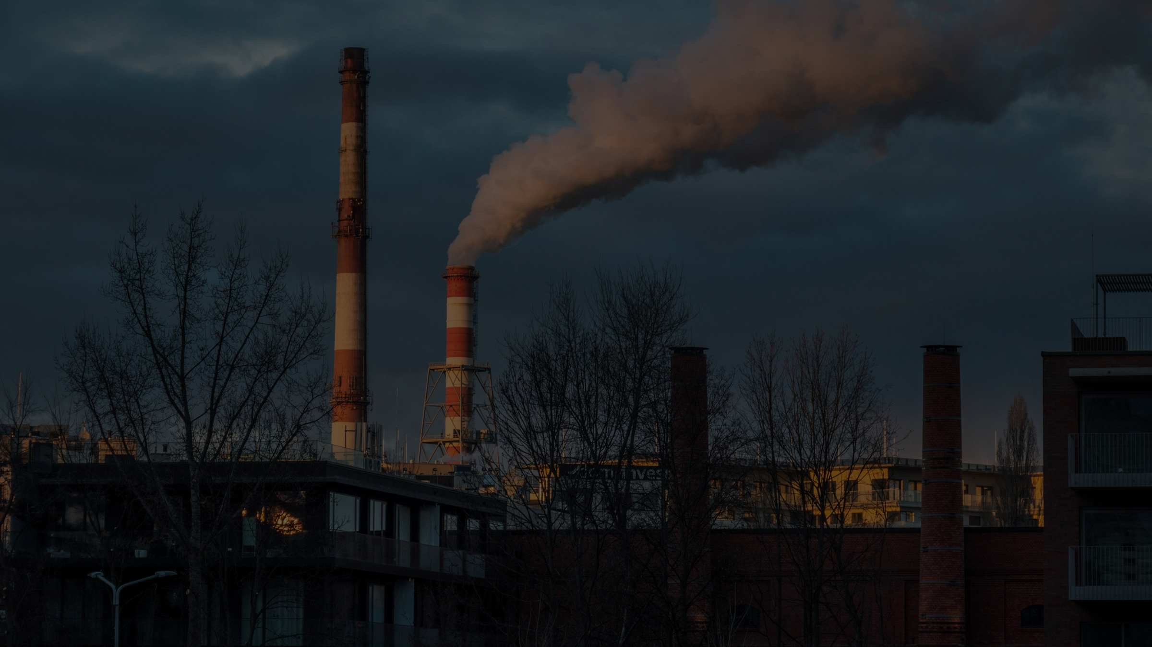
Goals
•Which countries have the most polluted air and which ones have the healthiest?
•Which pollutant (CO, NO₂, O₃, PM2.5) contributes the most to overall air pollution?
•Is there a statistically significant correlation between the concentration of CO2, NO₂, O₃, and PM2.5?
•classify countries into Good / Moderate / Unhealthy
•Is there a correlation between population density and high levels of specific pollutants?
•Number of people that are in risk of air pollution
•How much does pollution levels vary between developed and developing countries?

Slide 8
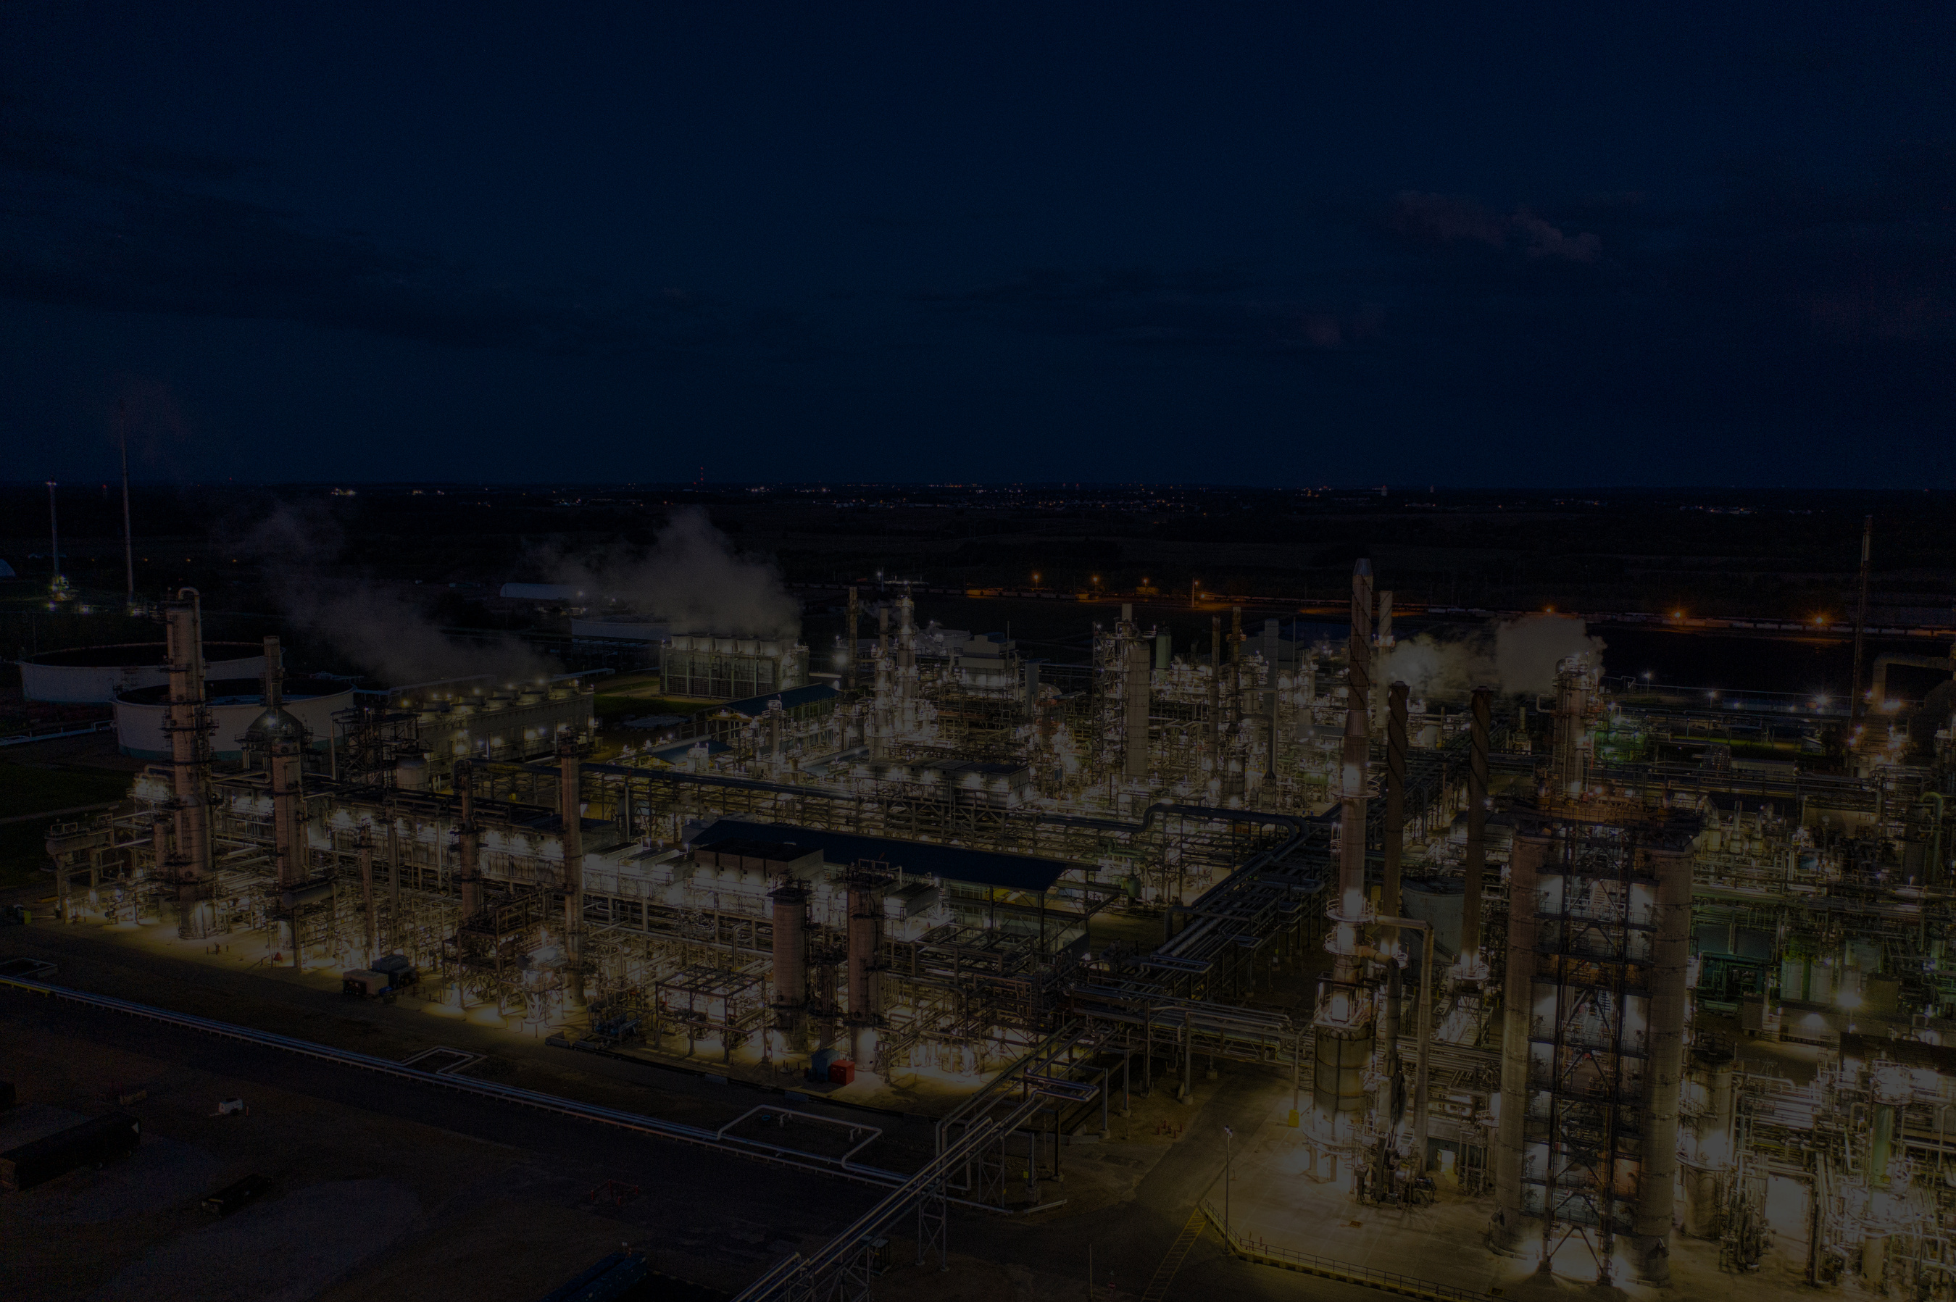
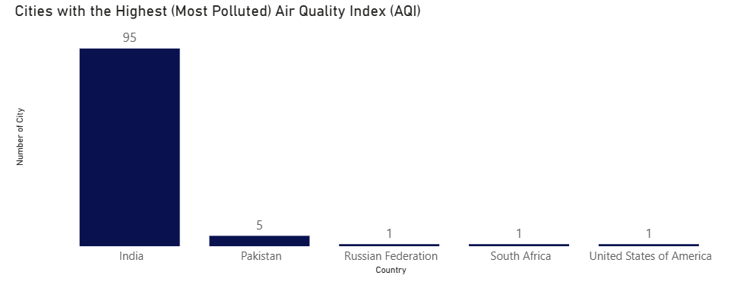


Slide 9

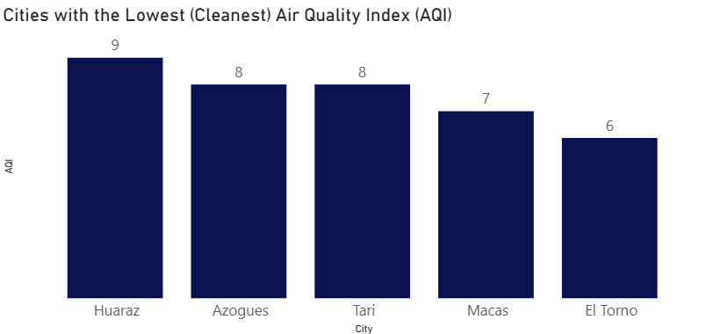


Slide 10
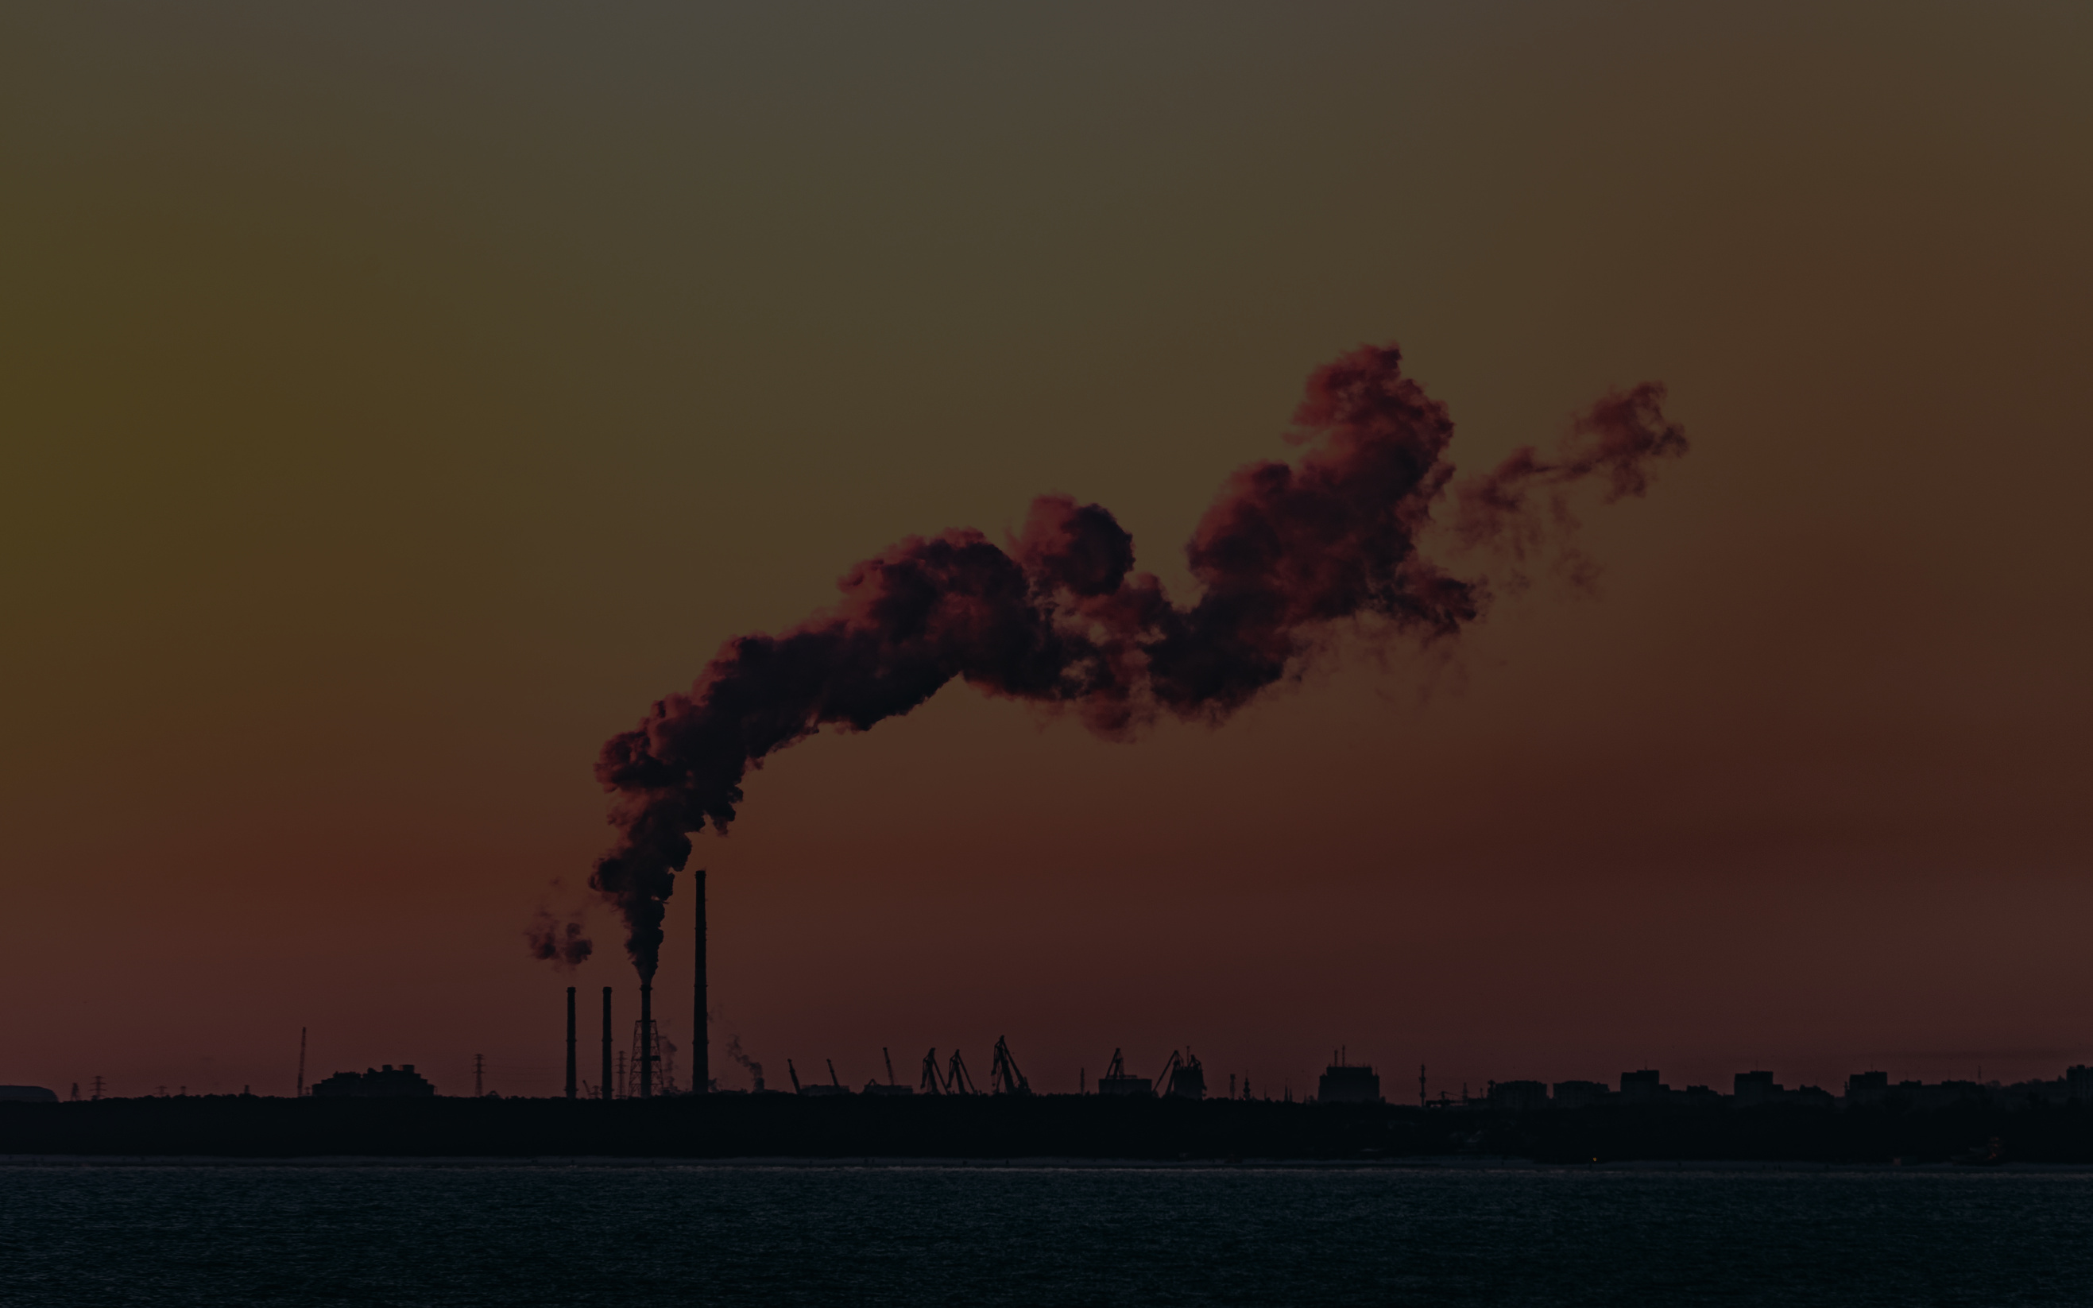
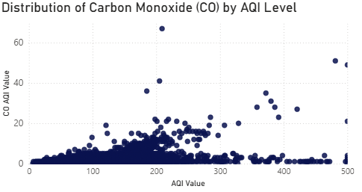
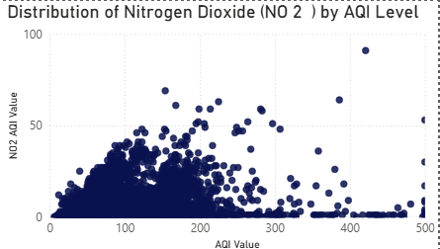
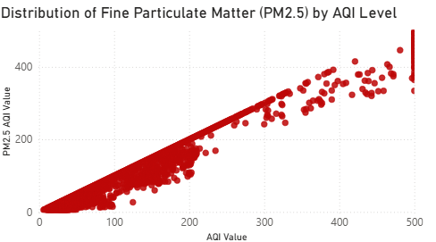
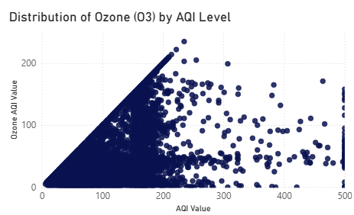

Slide 11
